Slide 1

Barriers To Economic Growth and/or Development
4.9
Copyright Bananaomics

Slide 2

What do you think some of the biggest real-world barriers are to economic growth and/or development.
COME UP WITH 2-3 ANSWERS
Copyright Bananaomics

Slide 3

Poverty Traps & Cycles
Copyright Bananaomics

Slide 4

Poverty Cycle & Traps
Economists debate the existence and effects of poverty traps or cycles. Governments use these diagrams to formulate greater understanding to guide intervention and if it's possible to break out of the cycle.
Copyright Bananaomics

Slide 5
Poverty Cycle Diagram
Poverty cycle diagrams can be applied to economic growth or development
Economic Growth
Economic Development
Low Economic Growth
Low Education & Healthcare levels
Low levels of investment
Low Income
Low Human Capital
Low levels of savings
Low Productivity
Copyright Bananaomics

Slide 6

Economic Barriers
Copyright Bananaomics

Slide 7



Infrastructure
Infrastructure - Physical Capital in an economy that is often provided by governments such as roads, railroads, police, education services, airports, public transport, etc.
Importance of infrastructure in development/growth:
  Facilitates economic activity
  Ensures protection of citizens
  Poor infrastructure leads to poor supply chains leading to increased costs of production.
  Infrastructure includes components like gas, drinking water, communication systems, etc.
Copyright Bananaomics

Slide 8


Appropriate Technology
Technology that relies mostly on the relatively abundant factor an economy is endowed with. Typically small-scale, environmentally friendly, locally made, and affordable.
Technologies developed in high-income countries are typically sophisticated and require more capital equipment (electricity, factories, etc.)
While the technology developed in low-income countries typically use less capital, more labor, and easily repaired creating jobs locally.
Appropriate technology is related to sustainable development as it must be environmentally friendly and produced locally.
Copyright Bananaomics

Slide 9

Low Human Capital
Human Capital - The education, training, skills, experience and good health embodied in the labour force of a country.
Low human capital is a result of:
  Poor education
  Poor Healthcare
  Poor job training opportunities
Copyright Bananaomics

Slide 10

Dependence on the Primary Sector
Primary Sector - Anything derived from the factor of production land. Includes agricultural products, metals and minerals.
Typically, developing countries rely heavily on the primary sector while developed countries focus more on manufacturing or services.
Issues with dependence on the primary sector:
  Reliance on imports of manufactured goods and services
  Instability. Unpredictable changes in prices and yields (crops/mine).
  Exchange Rate issues - high demand for raw materials leads to an exchange rate increase lowering export competitiveness in other sectors.
  Political and Civil unrest. Land and natural resources are so valuable here, there is frequently conflict.
Copyright Bananaomics

Slide 11

Lack of Access to International Markets
Trade is very important for a country's economic growth and development. Access to global trade markets is uneven or restricted by protectionist policies for a significant portion of low-income countries. Typically, protectionist policies placed on developing countries are highly effective as easily substitutes are available from other countries due to low technology and capital.
IMPORTANT: It's important to note that some protectionist policies such as tariffs may be defensive and enacted by the lower-income country in order to protect infant industries to increase domestic competition.
Copyright Bananaomics

Slide 12
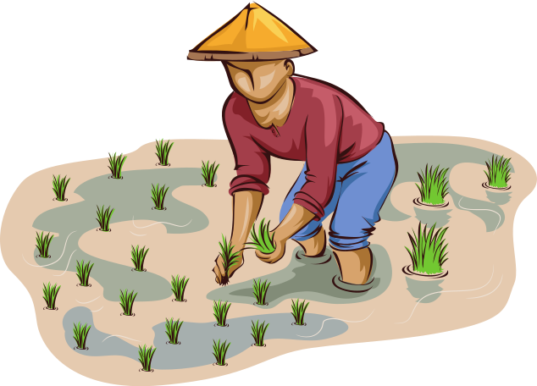
Informal Economy
Formal vs Informal Sector
Formal economic activity is registered, taxed, and legally regulated while informal activity is hidden, unrecorded, and unregulated.
Low-Income countries typically don't have the institutional framework to track trade as they lack established tax systems or record keeping. Citizens in low-income countries also typically grow, consume, and sell food, clothing, and shelter for their families, friends, and members of their local community.
Why is an informal economy a problem for development?
  Lower Incomes
  Lack of safety net for entrepreneurs or workers as they are not registered (no unemployment benefits)
  Lack of government revenue leading to less money for publicly private goods (education, healthcare, etc.)
  Potentially illegal economic activity resulting in human rights issues
Copyright Bananaomics

Slide 13

The Power of the Informal Economy
Robert Neuwirth: The power of the informal economy
TED
Copyright Bananaomics

Slide 14

Capital Flight
Capital Flight - An outflow of money from an economy. Typically these are due to negative political, social, or economic changes. It should be noted that countries normally have some outflow of funds but Capital Flight refers to a high degree of outflow.
Why is capital flight a problem for development?
  Interest Rates will rise in hopes of keeping money in the economy. However, this also discourages business and consumer loans.
  The government may enact control over funds leaving the country. While this keeps funds in the country, it serves as a deterrent for foreign investors as they may not be able to remove funds.
  Demand-Side policies have less of an impact.
  Lower domestic investment.
  In the long-run, capital flight is typically associated with large foreign debt
Copyright Bananaomics

Slide 15
Capital Flight in 90 Seconds
China’s capital flight explained | FT World
Financial Times
Copyright Bananaomics

Slide 16

Indebtedness
Why do countries take on debt?
  To service debts already owed. (Pay the principle on the loan)
  Finance current expenditures
  Finance long-term goals such as infrastructure, healthcare, industrial projects, etc.
The first two reasons are considered to be inappropriate as they further the amount of indebtedness and are considered to be unsustainable. The third example can be appropriate if funds are allocated effectively.
Debt from loans has increased dramatically in middle-low-income countries. While these loans can be beneficial for development and economic growth, they often come with strings attached as the developed lending countries promote their own agendas focused on international trade.
Copyright Bananaomics

Slide 17

G7 Article
Start with a 6-minute silent reading time.
Read the article and discuss the following topics with a partner
  What is the article discussing?
  Why is China investing in Africa?
  What is the purpose of lending the money to Africa stated in the article?
Copyright Bananaomics

Slide 18

Geographic Barriers
Copyright Bananaomics

Slide 19
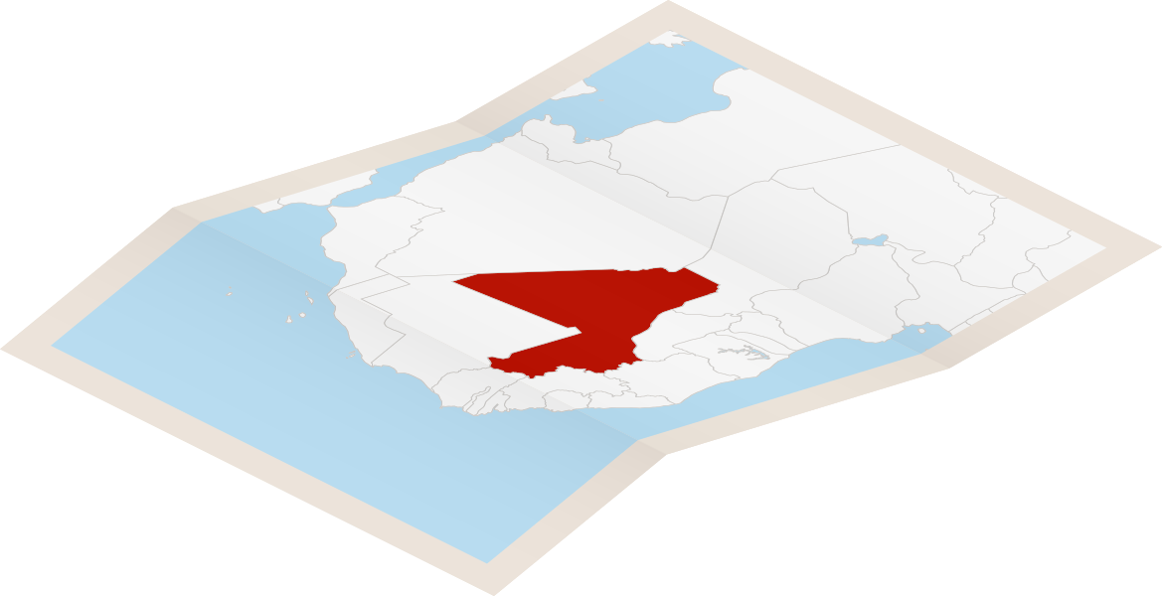
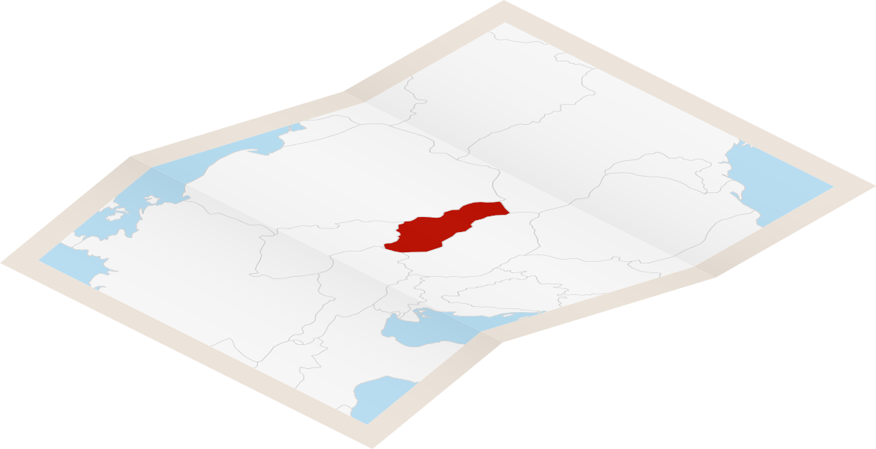
Landlocked Countries
Landlocked countries don't have direct access to the sea. This typically prevents easy economic integration as all imports/exports by sea must enter/exit through at least one other country.
Copyright Bananaomics

Slide 20

Climate
Each country lives in a different biome with varying climate conditions.
One of the largest issues with climate is drought. Due to lower-income countries' reliance on the primary sector (agriculture, raw materials, etc.), stressed water supplies typically result in lower crop yields. Higher-income countries focus less on the primary sector and therefore are less effected by drought.
Copyright Bananaomics

Slide 21
What is the most deadly animal in the world?
COME UP WITH AN ANSWER WITH A PARTNER
2 MINUTES
Copyright Bananaomics

Slide 22

Disease
Each country has different endemic diseases native to its region.
Issues with disease and development/growth
  An unhealthy workforce leads to a lack of development/growth
  Sick people cannot work and in countries with no safety nets, these people fall into a cycle of poverty.
  Sick people are unable to devote time to increasing human capital (education, training).
  Devastating impacts on overall well-being and relationships
Real-world examples of endemic diseases
  HIV/AIDS
  Malaria transmitted via mosquito (the most deadly animal) - most cases in Africa.
  Sick people are unable to devote time to increasing human capital (education, training).
  Devastating impacts on overall well-being and relationships
Copyright Bananaomics

Slide 23

Political Barriers
Copyright Bananaomics

Slide 24

Governance
Governance - Decision-making or processes within an organization or an institution.
Governance is not simply the government. Governance from non-government and government bodies greatly impacts economic growth and development.
Effective Governance Traits
  Transparent
  Accountable
  Consensus oriented
  Equitable and inclusive
  Follows rule of law
  Responsive
Copyright Bananaomics

Slide 25
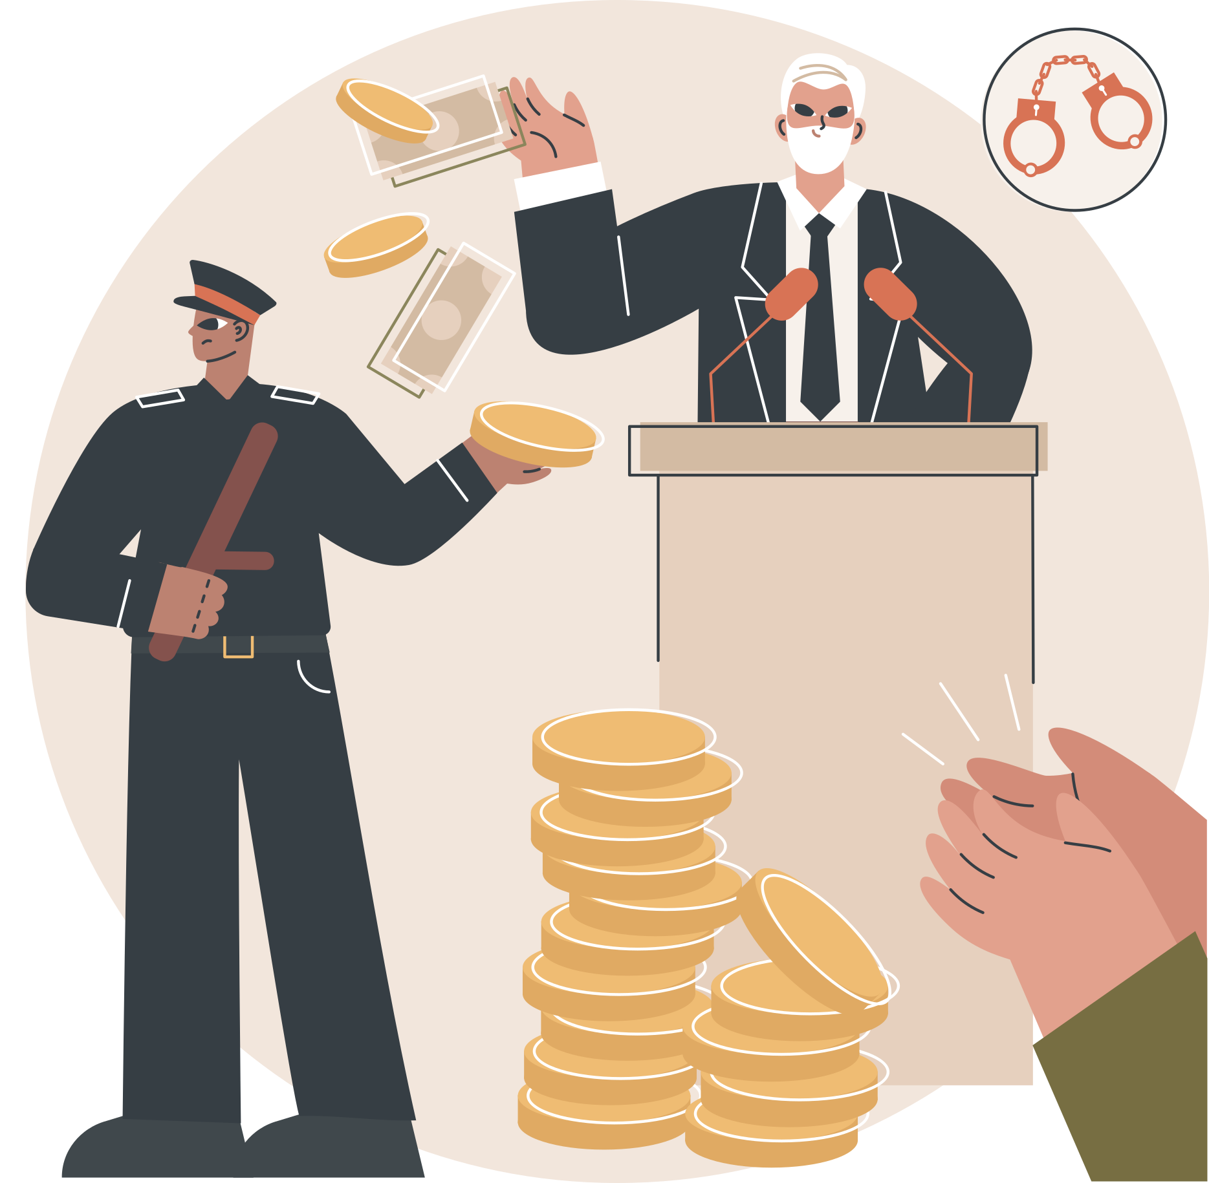
Governance
A lack of effective governance results in a power asymmetry (unsymmetrical power) where specific stakeholders have greater power.
Power asymmetry results in certain favored groups receiving preferential treatment and furthering the power disparity.
Copyright Bananaomics

Slide 26

Political Systems
Each country in the world has a unique political system ( legal institutions that determine government structure and functions).
While each political system should only be evaluated on a case-by-case basis, democratic political systems theoretically provide the greatest governance.
Copyright Bananaomics

Slide 27


Corruption
Corruption - Abuse of power for private gain.
Types of Common Corruption
  Bribery
  Embezzlement
  Extortion
  Blackmail
Copyright Bananaomics

Slide 28
Greek Corruption Case-Study
Fighting Corruption | Nikos Passas | TEDxAcademy
TEDx Talks
Copyright Bananaomics

Slide 29

Institutional Barriers
Copyright Bananaomics

Slide 30
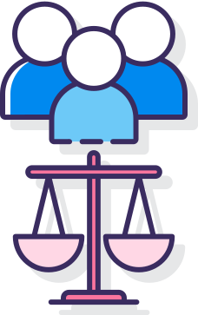
Legal Systems
Rule of Law - the ability of citizens to exercise power is restricted through well-defined and established laws.
Laws should uphold core foundations of ideal legal systems such as accountability, just laws, accessible and affordable justice, and transparency.
Copyright Bananaomics

Slide 31


Property/Land Rights
Systems need to exist to organize and structure the means of owning, selling and regulating property.
Countries that have no formal system of property records typically experience greater levels of hostility and general unrest. This lack of documentation and rights leads to challenges for economic growth and development.
Copyright Bananaomics

Slide 32

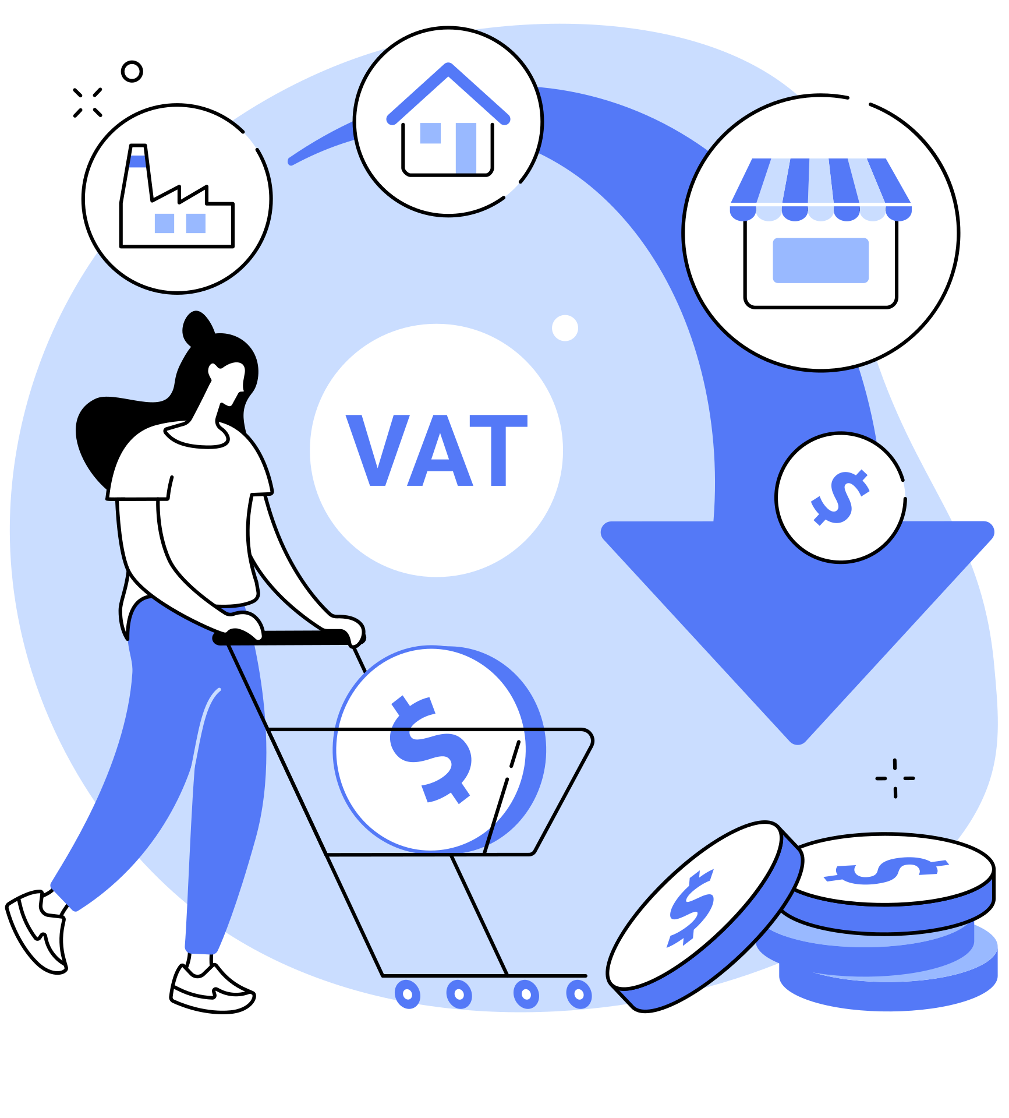
Taxation System/Structure
Typically, higher-income countries receive greater tax revenues compared to lower-income countries.
Tax revenues allow governments to boost economic growth and development through government spending. Additionally, because developed countries tend to have little/no informal economy, they receive most of their revenue from direct taxes while low-income countries with a large informal economy relies primarily on indirect taxes.
Copyright Bananaomics

Slide 33

Banking System
Banking systems in low-income countries take on a significant amount of risk in these areas as individuals typically have no collateral for loans, low savings, and low financial literacy. When a bank does choose to work with citizens to provide loans, they are typically with high-interest rates to ensure a profit is made.
This lack of access to finances hinders economic activity as entrepreneurs are unable to gain funds through bank loans. Additionally, citizens have a low degree of financial security as their money is not in a secure bank but most likely physically stowed away.
Copyright Bananaomics

Slide 34

Social Barriers
Copyright Bananaomics

Slide 35

Gender Inequality
Limits to women's access to education, healthcare, job opportunities, or political opportunities impact economic growth and development negatively in the following ways:
  Lack of education leads to a lack in human capital
  Unequal income
  Low political representation in government
  Little/no political or educational role models
  Increased sexual and physical violence against women
Copyright Bananaomics

Slide 36
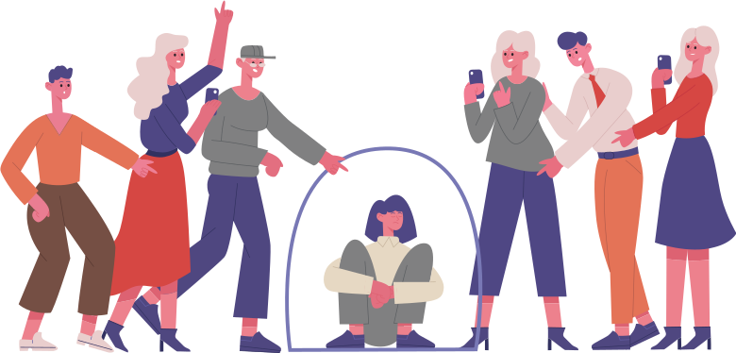
Caste and Ethnic Discrimination
Ethnic discrimination can be based on race, ethnicity, or social/cultural differences. Ethnic Discrimination is typically targeted against a specific minority group in the population and has been solidified for a long period of time or new immigrants.
Ethnic discrimination hinders economic development/growth resulting in:
  Higher rates of unemployment and income for minorities
  Lack of equal access to healthcare, education, and economic opportunities
  Restriction of freedoms
Copyright Bananaomics

Slide 37
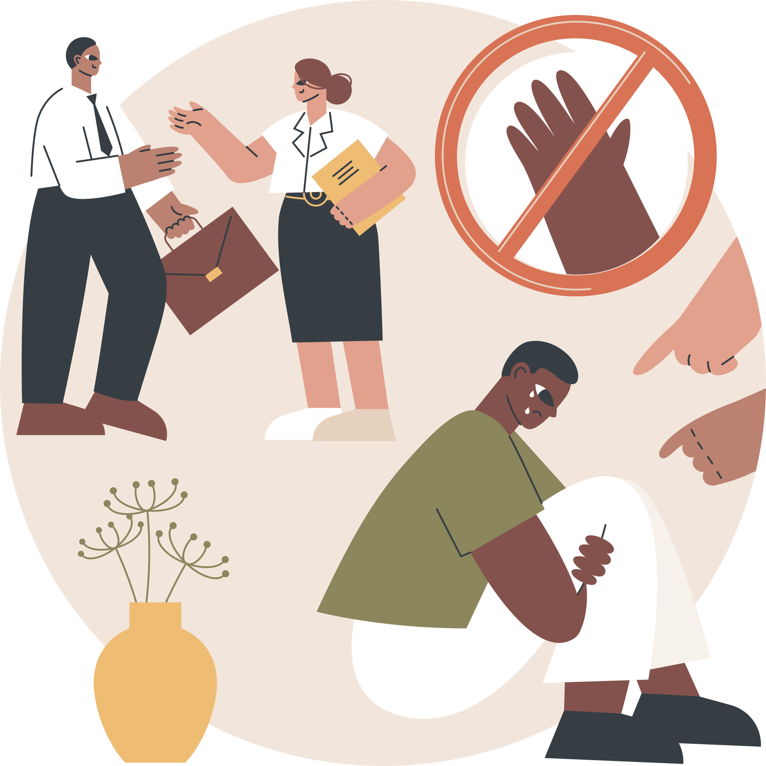
Caste and Ethnic Discrimination
Caste discrimination is primarily associated with South Asian countries such as India. Traditional caste systems divide the population hierarchically based on birth. Individuals in the lowest groups typically experience the most significant discrimination.
Copyright Bananaomics

Slide 38

Enjoying The Content?
Visit bananaomics.com to purchase package deals with discount prices!
BANANAOMICS

